Slide 1
Introduction to statistics
Statistics are "a quantitative technology for empirical science; it is a logic and methodology for the measurement of uncertainty and for an examination of that uncertainty." The key word here is "uncertainty." Statistics become necessary when observations are variable.

Slide 2
Goals of statistics
Estimate the values of important parameters
Test hypotheses about those parameters

Slide 3
Statistics is also about good scientific practice

Slide 4
A sample of convenience is a collection of individuals that happen to be available at the time.

Slide 5
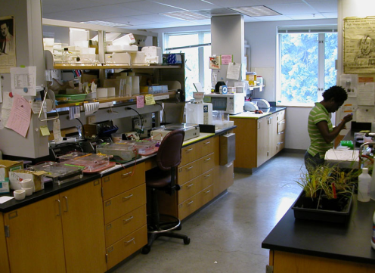
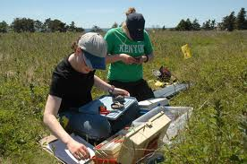
Why are statistics important?
As an environmental scientist or biologist:
Statistics are an important tool needed when developing and testing your own hypotheses
Necessary for understanding research done in your field

Slide 6

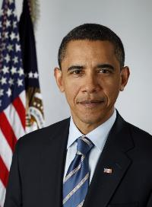
Why are statistics important?
As an informed citizen
Almost all scientific studies rely on statistics, examples include:
Do antiretrovirals extend life in patients with HIV?
Do antidepressants work?
Do vitamins improve health?
Are global temperatures significantly increasing?
Do most Americans think President Obama is doing a good job?

Slide 8
Goals
Introduce my dissertation work
Talk about the need for statistics
Talk about convenience sampling & best practices in research

Slide 9
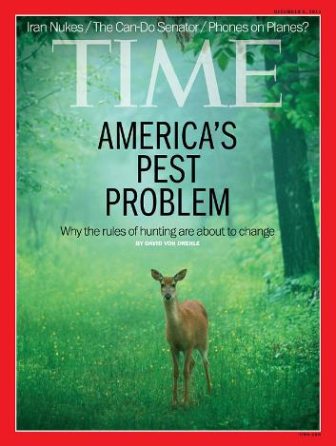

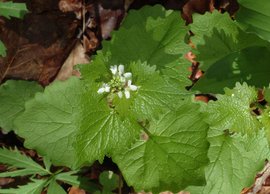
Focus of my dissertation:
Interactions between deer, invaders & native species
Management:
Is control necessary?
Basic ecology:
Importance of species interactions
regarding species interactions
Epistemology:
What do our (short-term) experiments miss?
Loss of herbivore-predator interactions
Novel species interactions
Notes:
In the news, and a big problem

Slide 10
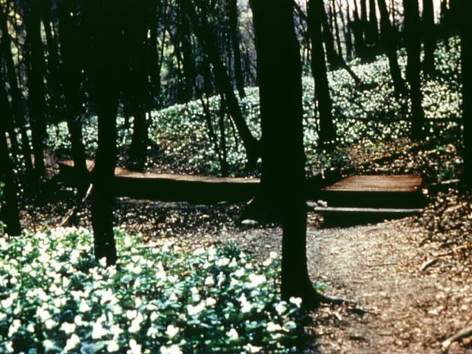
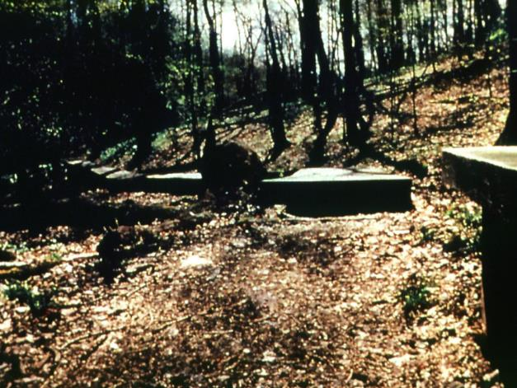
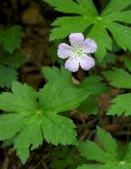
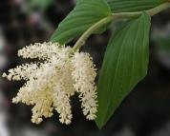
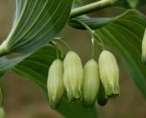
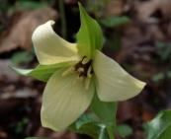
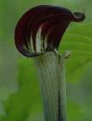
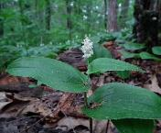
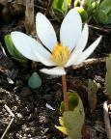
My system: Trillium Trail near Pittsburgh
May 1989 May 1992
:
Notes:
One of the 1st things I saw when I walked into the lab:
We’ve studied impacts of deer at a site TT
At the landscape scale deer were relatively low abundance in the early 1980s, increased in late 1980s, with obvious impacts on the plant community
Arial surveys in the 1990s and early 00s validated these estimates
http://vet.uga.edu/scwds/range-maps
*Now estimates to be 30-45 by QDMA

Slide 11

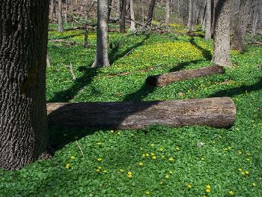
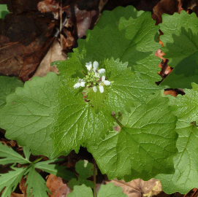

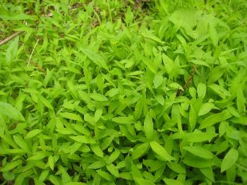
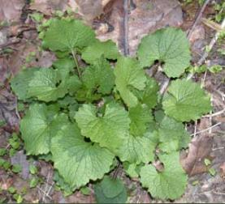
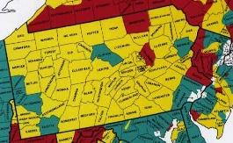
My system: Trillium Trail near Pittsburgh
Deer Impacts: Trillium Trail
May 1992
1982
Deer Abundance Allegheny Co.
Notes:
"Ranunculus ficaria, Fox Chapel, 2015-04-18, 01" by Cbaile19 - Own work. Licensed under CC0 via Commons - https://commons.wikimedia.org/wiki/File:Ranunculus_ficaria,_Fox_Chapel,_2015-04-18,_01.jpg#/media/File:Ranunculus_ficaria,_Fox_Chapel,_2015-04-18,_01.jpg
We’ve studied impacts of deer at a site TT
At the landscape scale deer were relatively low abundance in the early 1980s, increased in late 1980s, with obvious impacts on the plant community
Arial surveys in the 1990s and early 00s validated these estimates
http://vet.uga.edu/scwds/range-maps
*Now estimates to be 30-45 by QDMA

Slide 12
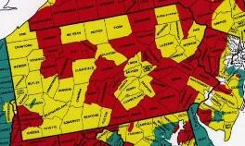
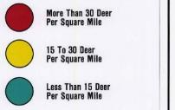

Cause of changes in forest are superficially simple
May 1989 May 1992
Deer Impacts at Trillium Trail
1982
1988
*Now estimated to be 30-45 by QDMA
Deer Abundance SW PA
vet.uga.edu/scwds/range-maps
Notes:
We’ve studied impacts of deer at a site TT
At the landscape scale deer were relatively low abundance in the early 1980s, increased in late 1980s, with obvious impacts on the plant community
Arial surveys in the 1990s and early 00s validated these estimates
http://vet.uga.edu/scwds/range-maps
*Now estimates to be 30-45 by QDMA

Slide 13
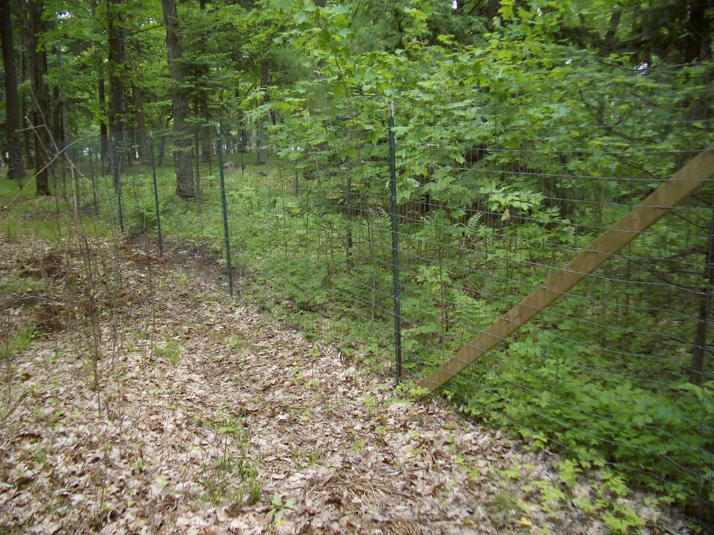
http://cherthollowfarm.com/2016/04/are-deer-bad-for-songbirds/

Slide 14
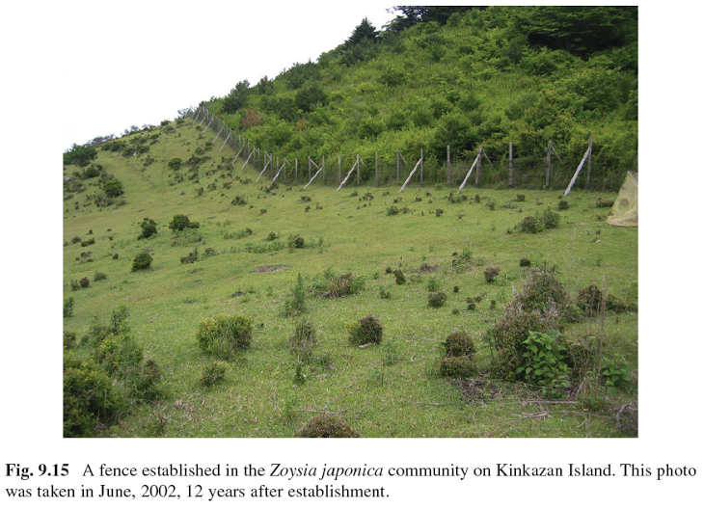

Slide 15
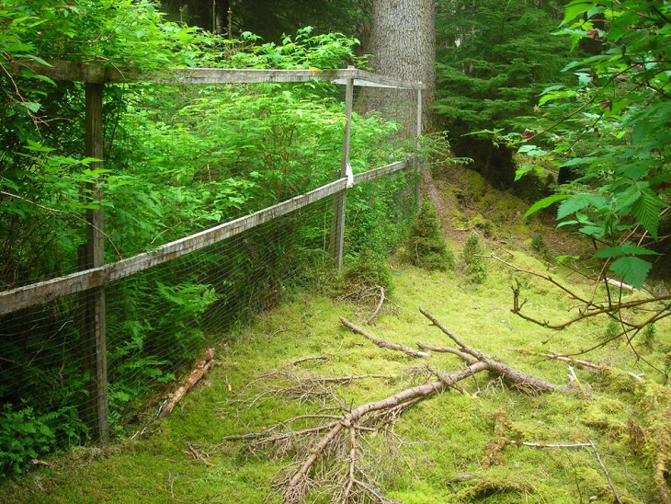

Slide 16
The role of statistics in this research
(or why you do actually need PhD to show that deer eating things is bad for them)

Slide 17
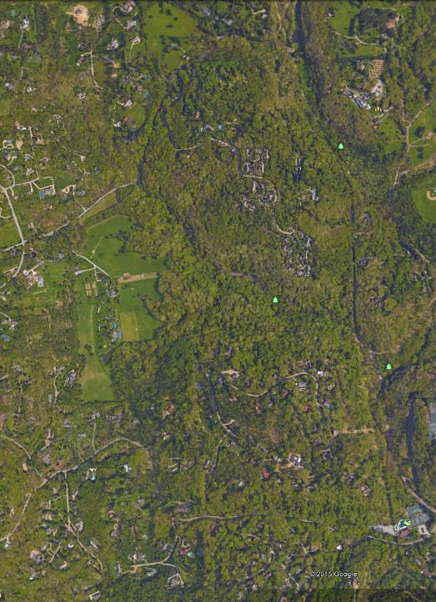
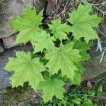
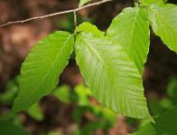
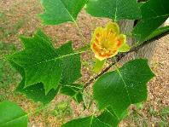
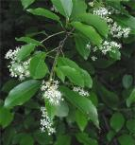
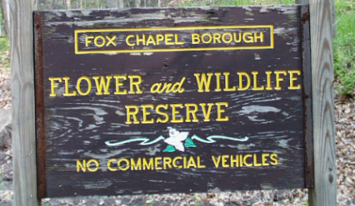

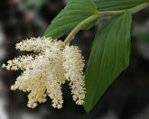
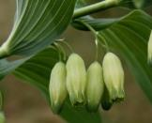

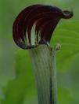
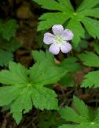
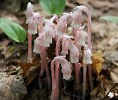


Study System:
Trillium Trail, Fox Chapel, PA

Slide 18
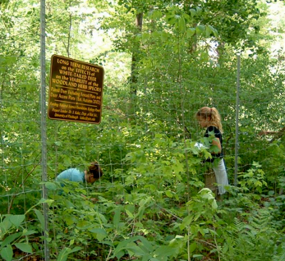
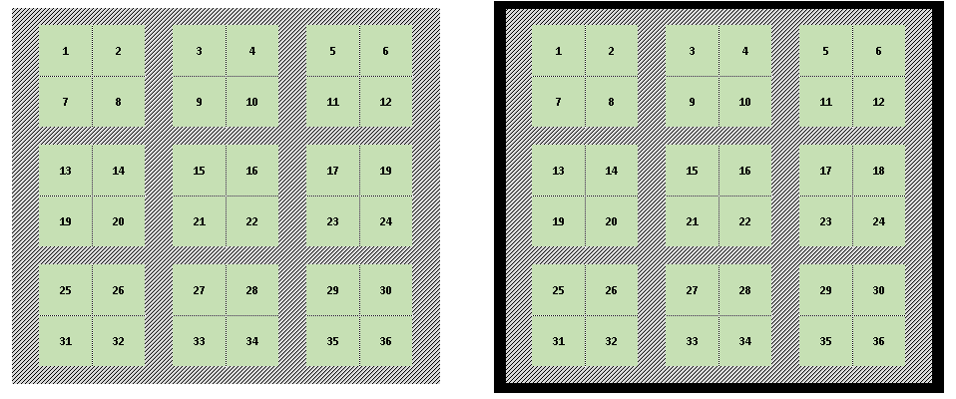
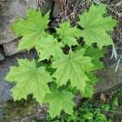
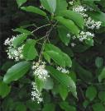
The Trillium Trail Demographic Experiment
2003 – 2015…
Deer Access
(Deer +)
Deer Exclusion
(Deer-)
x 7 pairs
Notes:
Intensive sampling in space and time

Slide 19
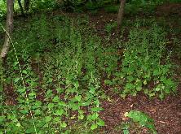
The Trillium Trail Demographic Experiment
2003 – 2006
Deer Access
(Deer +)
Deer Exclusion
(Deer-)

Slide 20
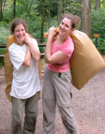
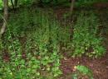
The Trillium Trail Demographic Experiment
2006
Deer Access
(Deer +)
Deer Exclusion
(Deer-)
Alliaria
Removal
(Alli-)
Alliaria
Ambient
(Alli+)
Alliaria
Removal
(Alli-)
Alliaria
Ambient
(Alli+)
Notes:
-in the summer of 2006 all GM were removed from 1/2 of each access & exl plot
-in the other 1/2 GM remains at ambient densities & undergoes it normal pop dynamics.
-A barrier is erected to prevent seed dispersal between the 1/2s of each plot
-& each spring all seedling that emerge from the seed bank are removed
-Using the data from 2006-2013, I have been using longitudinal statistical models to understand how deer and Alliaria impact the vital rates & pop characteristics of these 3 spp.
-We want to know how the continued exclusion of deer affects Trillium
& compare the rapid response of Trillium to other natives
-We also wan to know if the Alliaria deer brought onto the scene can influence vital rates & pop dynamics

Slide 21
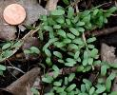
The Trillium Trail Demographic Experiment
2007 – Present
Deer Access
(Deer +)
Deer Exclusion
(Deer-)
Alliaria
Removal
(Alli-)
Alliaria
Ambient
(Alli+)
Alliaria
Removal
(Alli-)
Alliaria
Ambient
(Alli+)
Notes:
-in the summer of 2006 all GM were removed from 1/2 of each access & exl plot
-in the other 1/2 GM remains at ambient densities & undergoes it normal pop dynamics.
-A barrier is erected to prevent seed dispersal between the 1/2s of each plot
-& each spring all seedling that emerge from the seed bank are removed
-Using the data from 2006-2013, I have been using longitudinal statistical models to understand how deer and Alliaria impact the vital rates & pop characteristics of these 3 spp.
-We want to know how the continued exclusion of deer affects Trillium
& compare the rapid response of Trillium to other natives
-We also wan to know if the Alliaria deer brought onto the scene can influence vital rates & pop dynamics

Slide 22
There is variation between
Variation we’re interested in
Variation we are not so interested in
Treatments
Remove deer
Remove invader
Remove both
(but deer impact probably bigger than invader)
Native Species
Change over time
Plots
Subplots
Soil
Individual plants
Between years due to weather
Mis-measurement
Data-errors

Slide 23
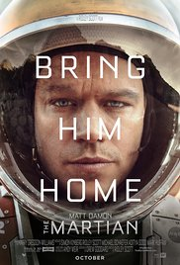
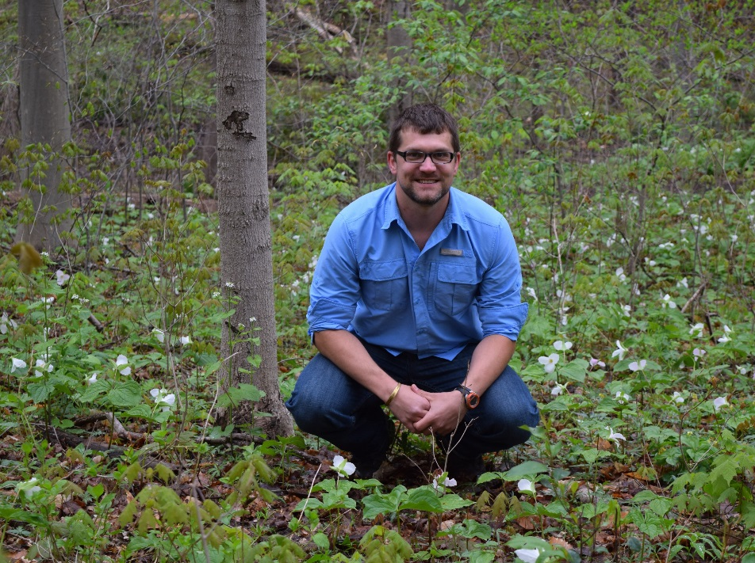
“In the face of overwhelming odds, I'm left with only one option, I'm gonna have to science the sh*t out of this.”
“In the face of every kind of variation you can imagine, I'm left with only one option, I'm gonna have to statistics the sh*t out of this.”

Slide 24
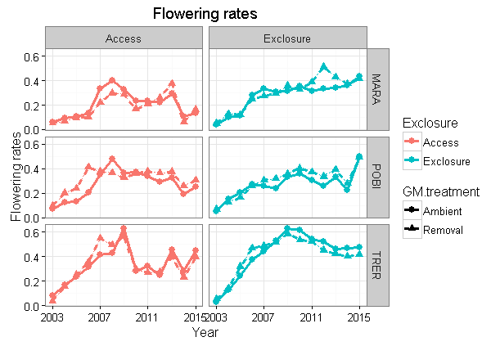
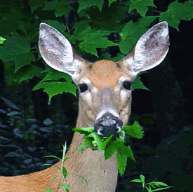

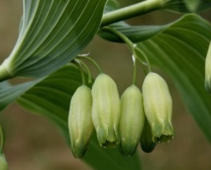
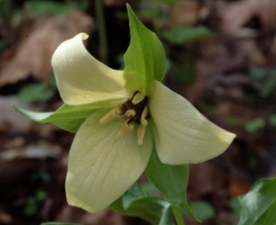
FLOWERING
We excluded deer, and EVERYTHING started flowering more?
What?

Slide 25
FLOWERING
Stats show that rate increased faster inside fence

Slide 26
FLOWERING
Stats show that cycles emerge where deer have access

Slide 27
FLOWERING
Stats show that cycles emerge where deer have access

Slide 28
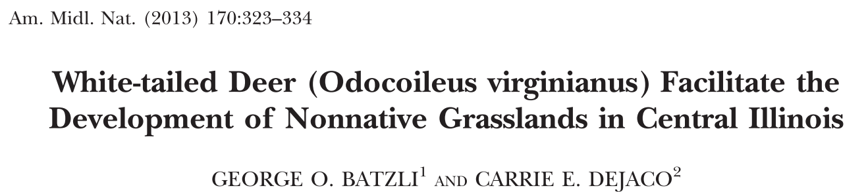







The many effects of deer on forests:

Slide 29







New area of research: deer and invaders

Slide 30




Slide 33
Trillium photosynthesis INCREASED without deer
Opposite of other 2 species
Why?

Slide 34

Hand waving answers:
-Trillium is different/special
-flap flap flap

Slide 35

Real Answer:
Mason set up a new experiment
All the samples of Trillium were collected next to this one site in the forest
Other samples more “haphazard”

Slide 36
For Next Lecture
To Do:
What we’ll do
Read Chapter 1
Talk about what makes a good sample

